Slide 1
Choco de Luxe
Sales Performance Analysis
Unlocking Sales Insights Through Data Visualization
for a European Artisanal Chocolate Brand
€5.13M
€2.36M
46%
1,046
Total Revenue
Total Profit
Profit Margin
Completed Orders
Presented by Ajibola Alalade | 10Alytics Capstone Project | 2024

Slide 2
Business Introduction
About Choco de Luxe
Operations Across Europe
Choco de Luxe is a premium artisanal chocolate brand headquartered in Brussels, Belgium, with operations across 7 European cities.
The company distributes chocolate bars, bites, and confections through three channels: Website, Warehouse, and Social Media.
With a growing product line of 21 SKUs across 10 categories, the brand aims to maintain high-quality standards while increasing European market share.
Turin, Italy
€1.01M
Barcelona, Spain
€970K
Amsterdam, Netherlands
€925K
Zurich, Switzerland
€677K
Brussels, Belgium
€604K
Hamburg, Germany
€586K
Lyon, France
€358K

Slide 3
Problem Statement & Project Aim
The Problem
Despite strong product quality and market presence, Choco de Luxe lacks a unified, data-driven view of how its products, salespeople, and delivery strategies are performing across Europe. Leadership needs actionable insights to optimise sales strategy, delivery efficiency, and regional performance.
Analyse Performance
Identify Patterns
Deliver Insights
Examine sales across locations, channels, and product lines to identify what is driving and dragging revenue.
Uncover inefficiencies, workforce gaps, cancellation trends, and growth opportunities across the business.
Produce interactive Tableau dashboards to help leadership make informed decisions on product and channel strategy.

Slide 4
Chart 1: Location Sales Performance
Business Question: Which cities are top performers and which need attention?
Key Insights
🥇 Turin leads at €1.01M — 20% of total revenue
🏆 Top 3 cities (Turin, Barcelona, Amsterdam) = 57% of revenue
📉 Lyon is the lowest performer (€358K) but has a 0% cancellation rate — reliable, untapped market
⚠️ Brussels & Hamburg have 7.3% cancellation rate — highest in the network
💡 Recommendation: Investigate logistics in Brussels & Hamburg; expand marketing in Lyon

Slide 5
Chart 2: Channel Effectiveness
Business Question: Which sales channel is most profitable and drives the most transactions?
Key Insights
🌐 Website is the dominant channel — €2.34M revenue (45% of all orders)
🏭 Warehouse generates the highest average order value at €5,050 per transaction
📱 Social Media has the lowest avg. transaction (€4,694) but strong scaling potential
⚖️ All 3 channels share an identical 46% profit margin
💡 Recommendation: Focus growth on Website volume; use Warehouse for premium orders

Slide 6
Chart 3: Salesperson Productivity
Business Question: Which salespeople hit the €100K profit target — and who needs support?
Key Insights
🏆 Karlen McCaffrey leads at €125,868 — 26% above target
✅ 10 of 25 reps (40%) hit the €100K profit target
❌ 15 reps (60%) are below target — avg. shortfall: €18K
📊 Average profit per salesperson: €94,352 — just below threshold
💡 Recommendation: Coach mid-tier reps (€80K–€99K) to push hit rate above 50%

Slide 7
Chart 4: Product-Level Profitability
Business Question: Which products and categories generate the most profit?
Key Insights
🏆 Eclairs is the star product — €184K profit, 16,036 boxes
🍫 Dark Chocolate is the top category at 26% of total revenue
📦 All 21 products share a 46% margin — volume is the growth lever
⬇️ White Chocolate & Drinking Coco are the weakest categories
💡 Recommendation: Increase marketing & stock for Eclairs and 99% Dark & Pure

Slide 8
Chart 5: Organic vs Non-Organic Demand
Business Question: How does organic product performance compare across sales channels?
Key Insights
🌿 Organic SKUs = 3 of 21 products (14%) but generate 16% of revenue — above their weight
🏭 Warehouse has the highest organic share at 20% — organic buyers prefer in-store
📱 Social Media is the weakest organic channel at only 10% share
🌐 Website drives the highest organic volume at €406K
💡 Recommendation: Expand organic range and target Warehouse & Website channels

Slide 9
Summary & Strategic Recommendations
Location
01
Investigate fulfilment logistics in Brussels & Hamburg (7.3% cancellation rate). Pilot a targeted marketing push in Lyon which has 0% cancellations but low volume.
Channel
02
Scale Website volume — it drives 45% of orders at a 46% margin. Use Warehouse for premium/high-value order fulfilment. Invest in Social Media paid campaigns.
Salespeople
03
Only 40% hit the €100K target. Introduce a coaching programme for the mid-tier (€80K–€99K) reps — moving 5 to target would add ~€100K in profit.
Products
04
Double down on Eclairs and 99% Dark & Pure — highest profit products. Consider phasing out or repositioning White Chocolate and Drinking Coco (lowest performers).
Organic
05
Expand organic product range from 3 to 6 SKUs. Prioritise Warehouse and Website channels where organic buyers are most active. Use Social Media to build organic brand awareness.

Slide 10
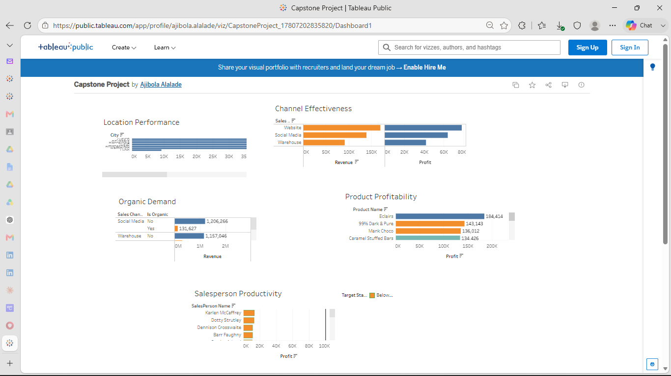
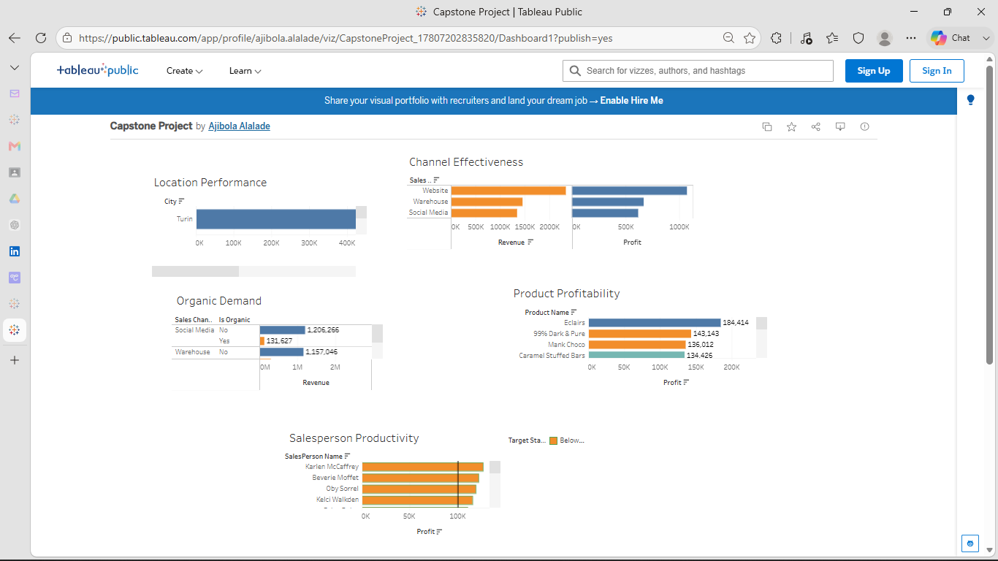
Interactive Tableau Dashboard
[Paste your Tableau Public dashboard screenshot here]
📸 Screenshot from: public.tableau.com/app/profile/ajibola.alalade
5 Analysis Areas
€5.13M Revenue Analysed
1,046 Transactions
25 Salespeople
21 Products

